Slide 1
HR Exploratory Data Analysis
TERMINATION PREDICTION OF EMPLOYEE
Anirudh N – AP21110010347
Diswanth M – AP21110010352
Neha Sree K – AP21110010376
Anjani Sai T – AP21110010378
Biswanth Ch – AP21110010380

Slide 2
Aim:
To analyse the HR data using EDA and prediction based of the termination status of employee using machine learning algorithm

Slide 3
Introduction:
Management of the human resources are complex and if the resources are managed in an effective way, the fallouts would be highly effective. We are driven by this motive and chose this domain to carry out the project.
We use the exploratory data analysis on the dataset to find the interesting and undiscovered information from the attributes. We use machine learning libraries to train the model.

Slide 4
About the dataset:
Dataset is made of
300+ records
36 attributes

Slide 5
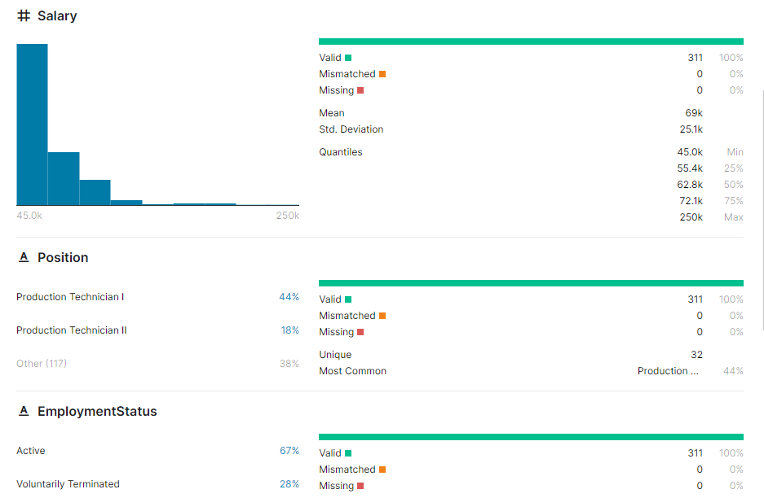
Meta data

Slide 6
Data preprocessing:
Checked Null values
Found one attribute with null
Could not find suitable strategy to fill the null values
Scaling of the data in the final step

Slide 7
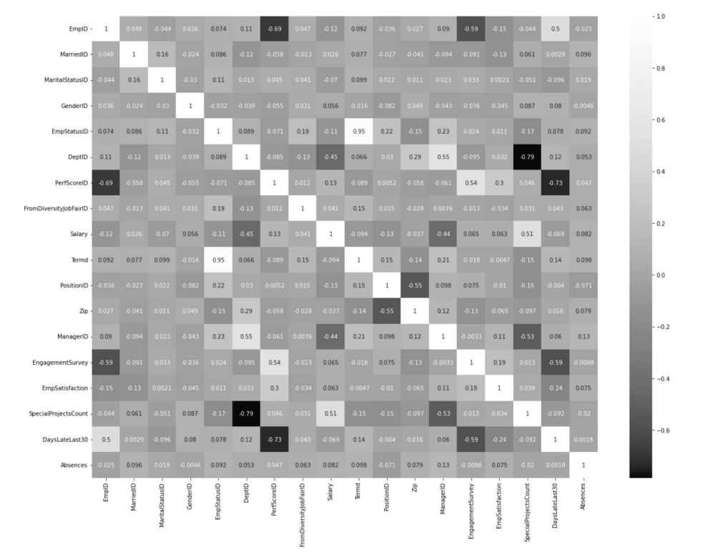
Correlation heatmap
The thicker the box, the strong the relationship between attributes

Slide 8
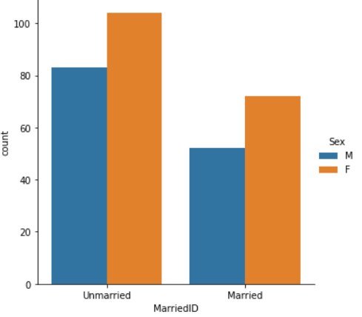
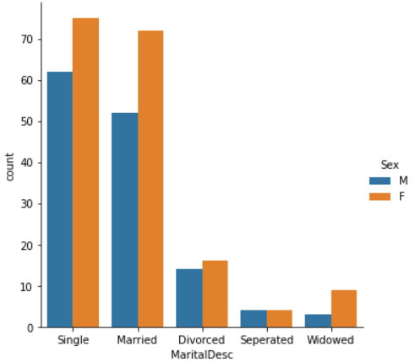
..
From graph[1], it is observed that the number of unmarried female are more than the Married male and female.
From graph[2], It is clear that single and married categories share majority of the people in the company

Slide 9
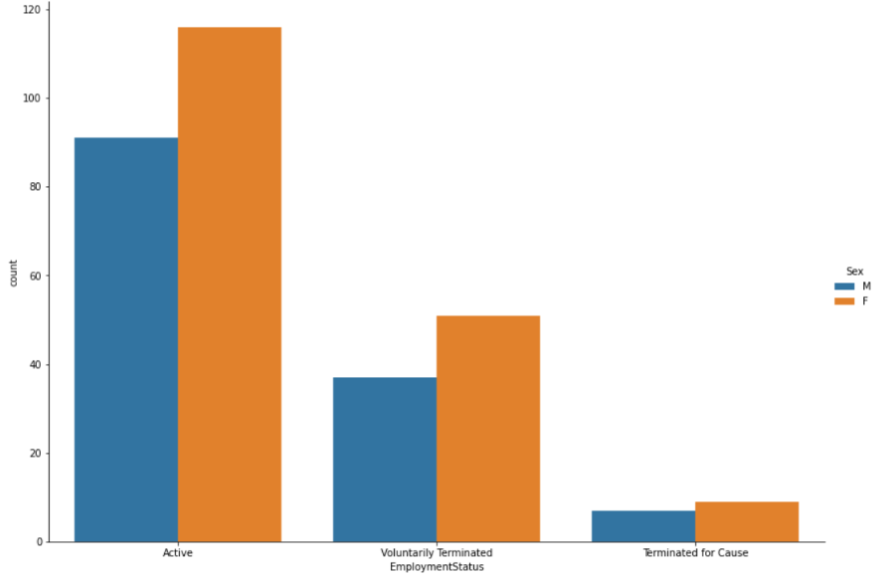
Employment Status:
Employment status in contrast with Male and female
There are more active Female than male in all the cases.

Slide 10
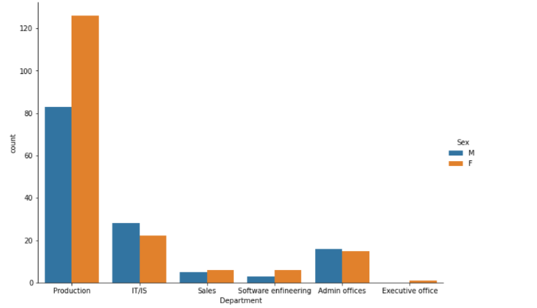
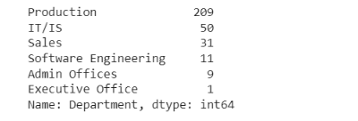
Department:
From the above department graph we can see that female employees are more in production department as compared to other

Slide 11
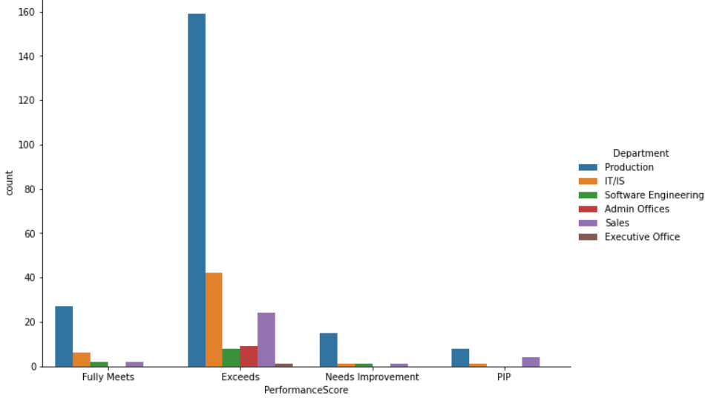
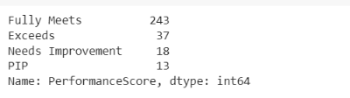
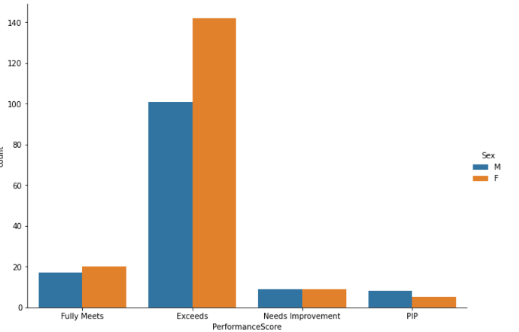
Performance Score:
From performance graph its clear that the production department exceeds the performance score.
From graph 2 it is observed that the females exceeds the performance score

Slide 12
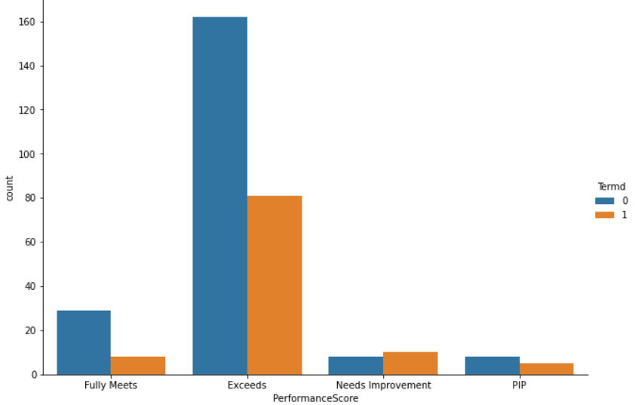
Performance score:
From the above graph, it is observed that males fully meets and exceeds the performance score and females need more improvement than males.

Slide 13
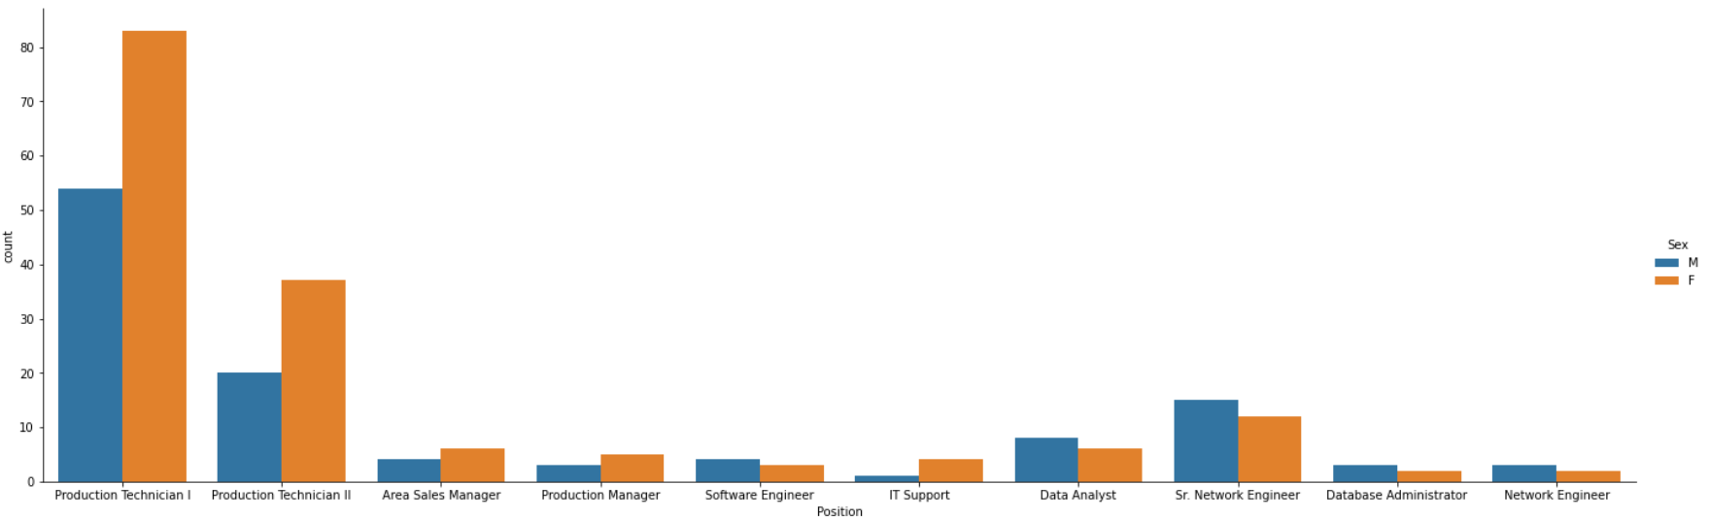
Position:
The number of female employees is more in the production technician 1 position

Slide 14
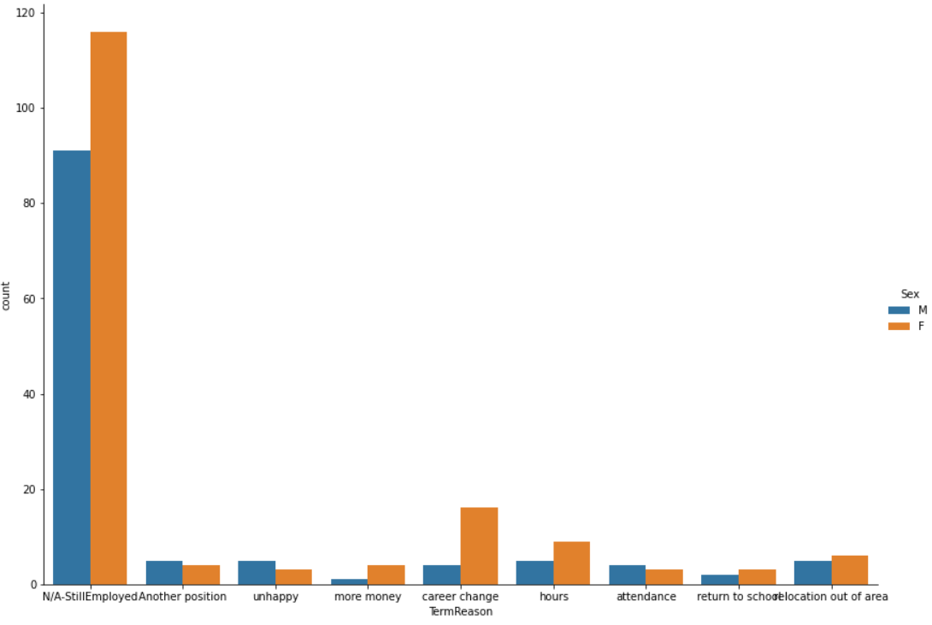
Term Reason:
From the above graph, it is observed that females are more in the employment field, they earn more than males, their work hours are more and they have high chances of career change.

Slide 15
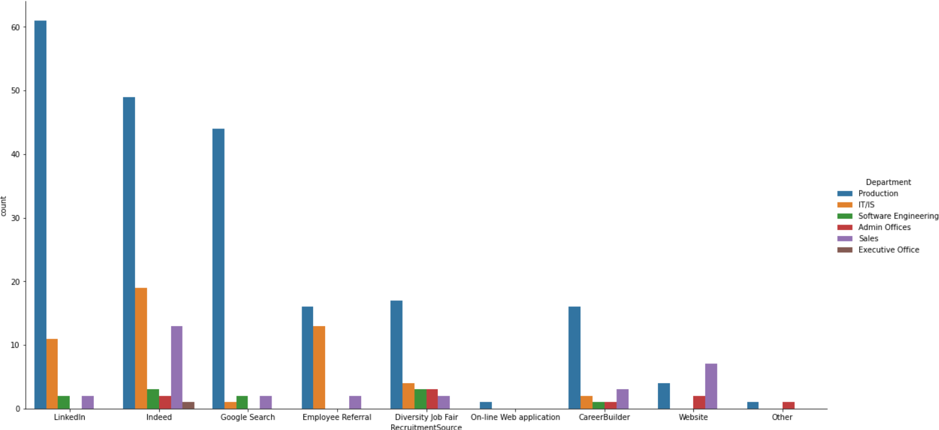
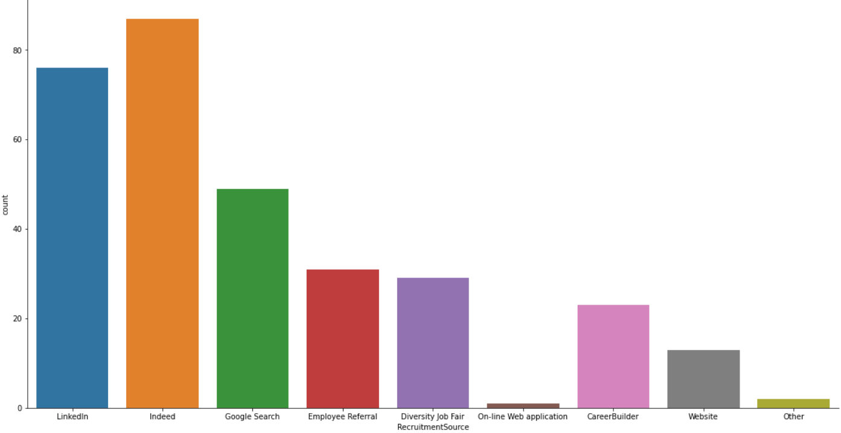
Recruitment Source:
From graph 1, that more number of employees are recruited through indeed followed by linkedIn
From graph 2, that more number of employees from production department are recruited through linkedin followed by indeed

Slide 16
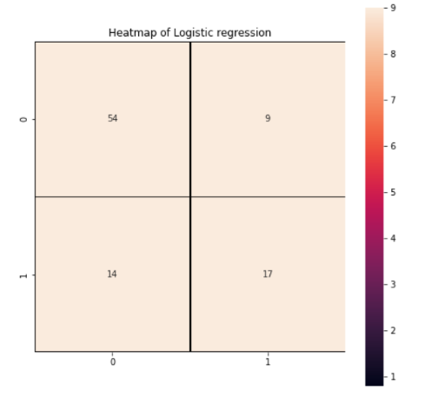
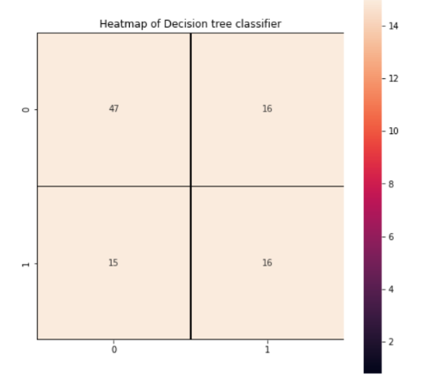
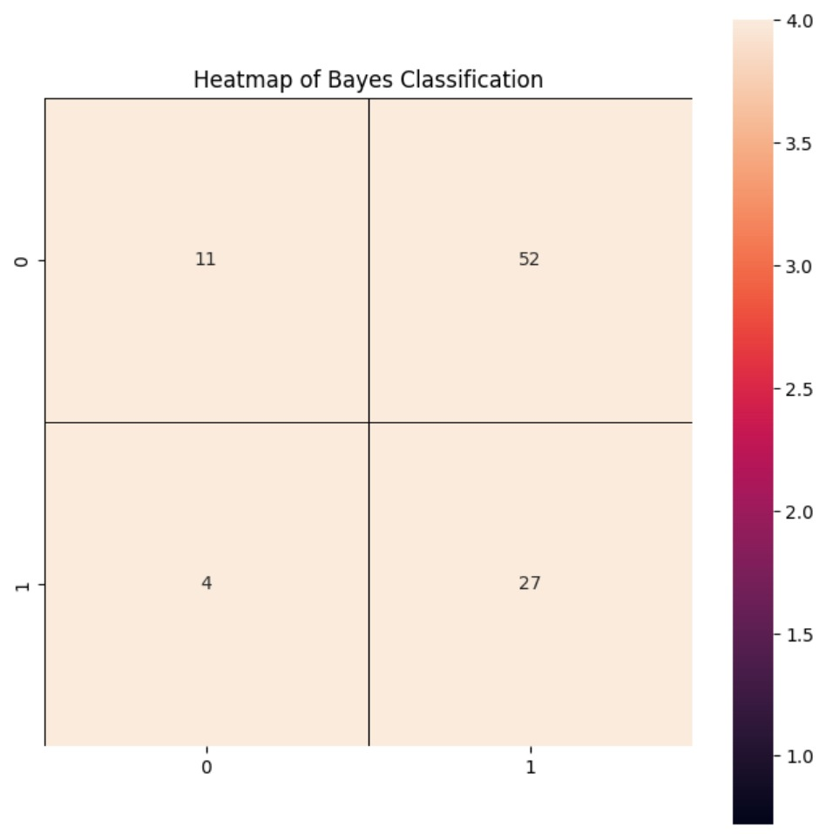
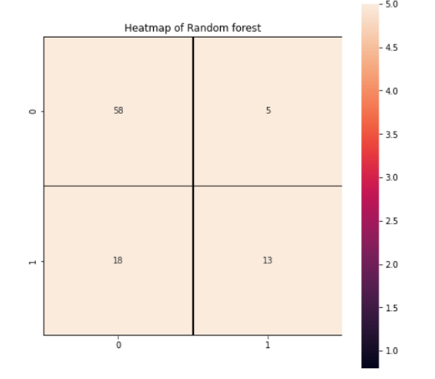
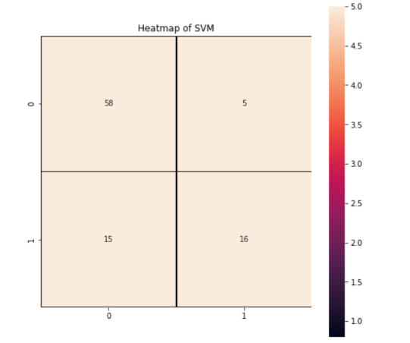
Confusion matrix of models

Slide 17
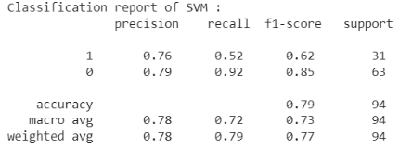
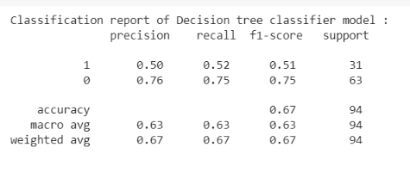

Slide 18
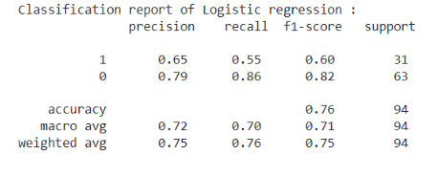
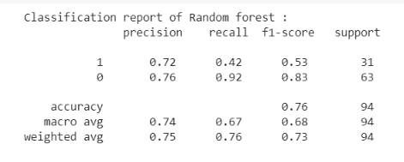
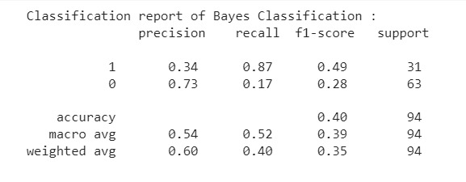

Slide 19
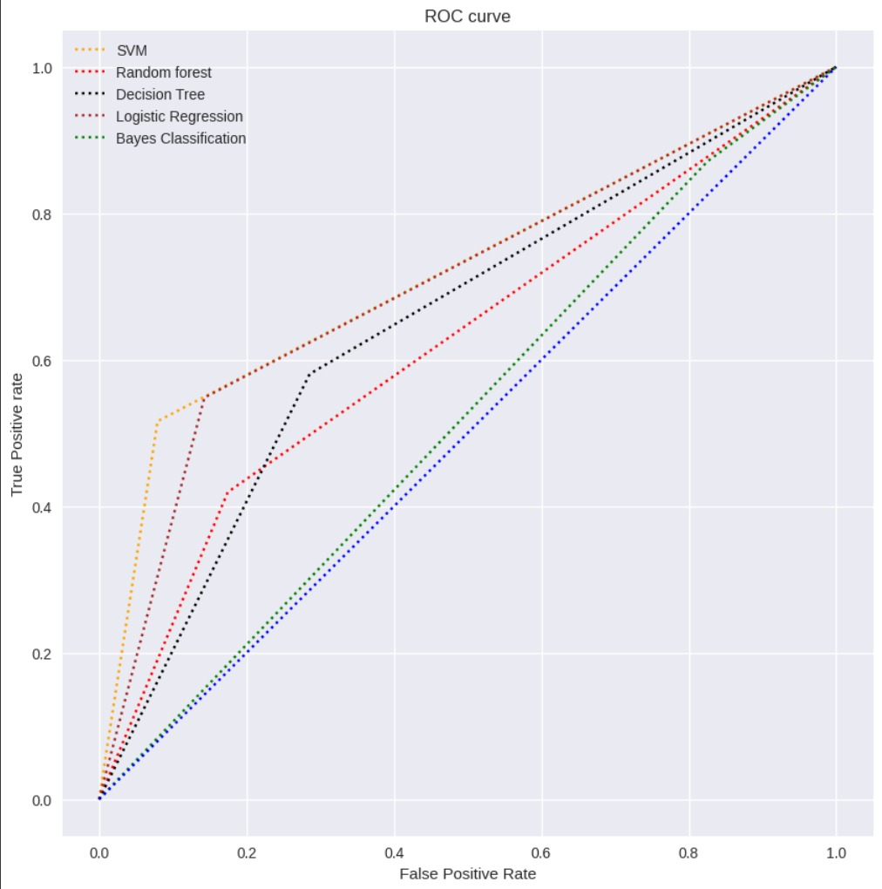
ROC Curve
An Roc curve is the graph which shows the performance of the model at all classification thresholds with two parameters, True positive and False positive rate.

